Slide 1
SDP PORTAL DEVELOPMENT

Slide 2
Introduction Of SDP Core & Products
ELM has different products and services hosted on web to enable access of government services to its customers
ELM’s envisioned Service Delivery Platform is defined as a software platform deployed at ELM and across different partner boundaries, enabling the development, testing and delivery of services to different customers including individuals, businesses and government.
As such the SDP provides multiple environments to ELM implementation team and other teams providing business services leveraging SOA concepts.
SDP core comes as Common Screens(heart of the system)
Applications can be termed as SDP products which will be on boarded on it.
SDP has SDP Core as kernel platform with different Products over it where in Liferay each product is configured as one instance with its own theme and portlets .

Slide 3
Dependent Systems:
Dependent Systems:
ESB as a backEnd system for Business and Database Service
IDAM – for Authenticaion and Authorization Purpose
SOA governance System – For Business and Network governance
Caching Server –Using distributed Caching mechanism
Sharepoint server as DMS

Slide 4
Dependent Systems:
Component | Sub-Component | Technology
Platform | Portal | Liferay 6.1
 | Business & Core Services | webMethods
 | Identity Management | WSO2 IS
 | SOA Governance | SOA Software
 | DB | MS-SQL SERVER
Billing | Transaction Based Billing | Orcacle BRM
Environments | Dev,SIT,UAT,Stage,Prodution | Liferay 6.1 CE & EE

Slide 5
Continuing…
Currently Liferay is used at Presentation Tier with minimal liferay features implemented
UserManagement :
Storing Users in Liferay DB also in the LDAP which is the user store for the Identity Server used for authentication and authorization
Role Management :
Liferay feature for Role Management is not being used .Instead Identity Server of WSO2 with LDAP as user store is being used for authentication and authorization (Authentication/Authorization)
Permission
Liferay feature of Page permission system is not being used, instead every page access is being authorized and the page load if the authorization succeeds.

Slide 6
Portal Development Standards
All the custom plugins built for the applications should be Spring MVC portlets/plugins with JSR-286 standards
Using Liferay-jboss7.1.1(Community Edition(CE)) version server for local development on Windows operating system & while migrating to other environments using the same version with Enterprise Edition/EE on Linux Operating system.
Entire development flow majorly involves three layers.
Presentation Layer
Middleware/Controller Layer
Implementation Layer
Using of cross-platform javascript library (Jquery1.8.2 or above version) to enable developing AJAX applications.
Using of JSTL & Liferay API tag libraries

Slide 7
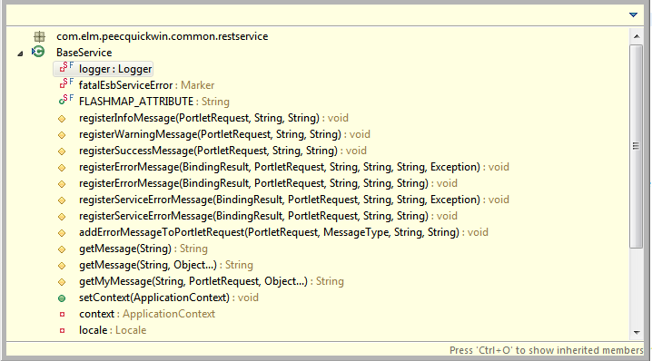
SDP Framework & Utilities
Error Handling : Showing any kind of Error/Success/Warning will be using common utility functions/methods as shown in below screenshots.

Slide 8
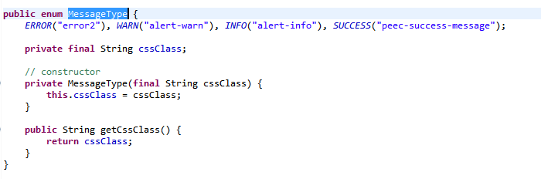
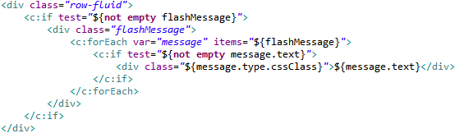
Continuing…
Below code shows the code built on jsp to represent all the error/success/warning scenarios.

Slide 9
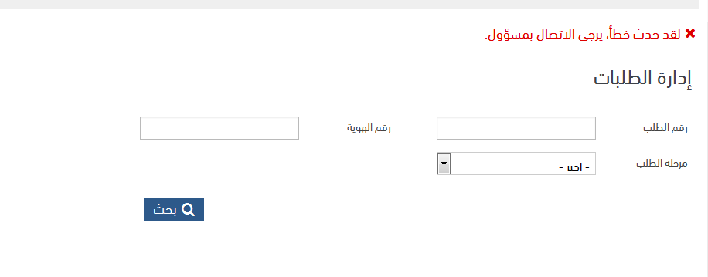
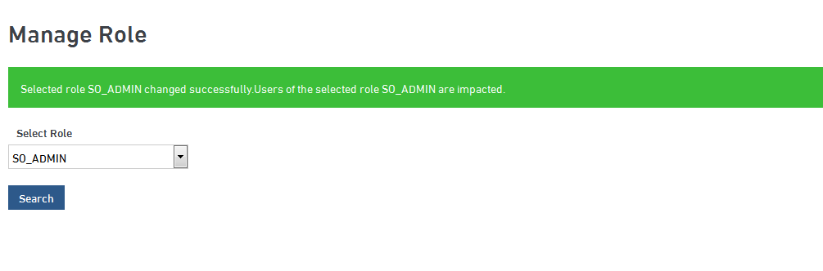
Continuing…
Example of screens :
Error will be represented in Red color. Whereas success will be represented as green color & warning message will be represented in blue color.

Slide 10
SDP Components
As per the implementation w.r.t to SDP framework, there are some set of components which are required to be engaged with the framework. Below are the Components.
SDP Logging
Config Cache
SDP Audit
SDP Exception

Slide 11
SDP Logging …
This is specifically for portal to keep track of transactions that take place between Portal & Web methods. For utilizing this, you need to use SDPLogging.jar from where you can import required method signatures.
Before & After Invoking the Web methods,we need to make an entry by using the method signature “performInfoLog(……..)”
In exception block make sure you have an entry of method signature “performErrorLog (….)” which will track the exception trace.

Slide 12
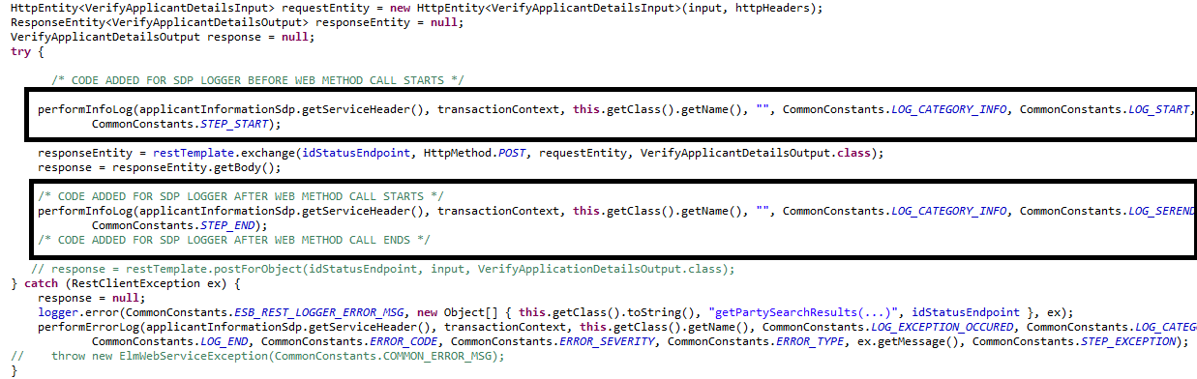
Continuing…

Slide 13
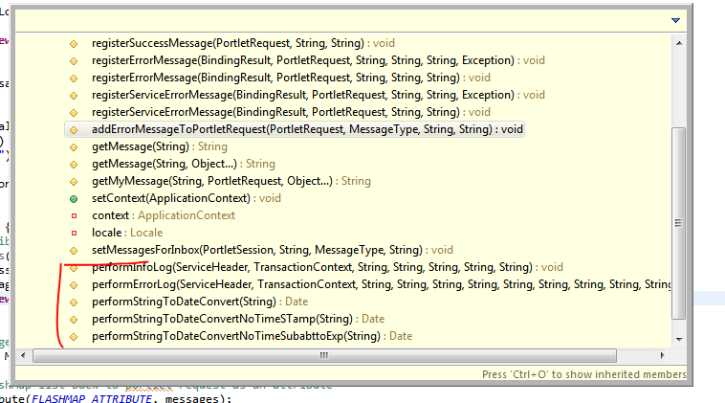
Continuing…

Slide 14
Config Cache…
In SDP framework, we will not interact directly with database. There is a separate database available for SDP. To interact with those tables we need to use the config cache framework(cf-core.jar) which will initialize all the required data.
Initially while server startup all the categorized configurations will be loaded and cached using the custom api’s(cf-core.jar,EC_userContext.jar) implemented
At runtime based on the attributes/parameters passed to the query which will further execute from the cache and return the results
Usage:
Define a Global Variable called cfHelper like shown below.
private static ConfigurationHelper cfHelper = ConfigurationHelper.getInstance();
Make Sure you Enter your Query in TBL_CONFIG_PARAM with or without Parameters with the Key under the column PK_CONFIGURATION_NAME
Create a method and call getCacheObject Method like shown below where you have to pass the KEY as parameter
cfHelper.getCacheObject("DLV.BranchAdminPreDefineRole");
Note : This Method can have Parameters also

Slide 15
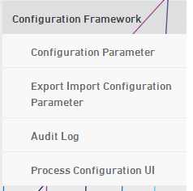
Continuing…
Using the following functions from core sdp screens. We can define the configurations which will be accessed through process flow.
Basically we have two types of configurations queries
Simple Configuration/Complex Configuration
Simple configuration will be used to fetch the default values/direct attribute
Complex configurations will be used to fetch the configured data based on the dynamic runtime parameters passed as a result set in form of dropdowns/multi selects/read only data/ documents for attachments.

Slide 16
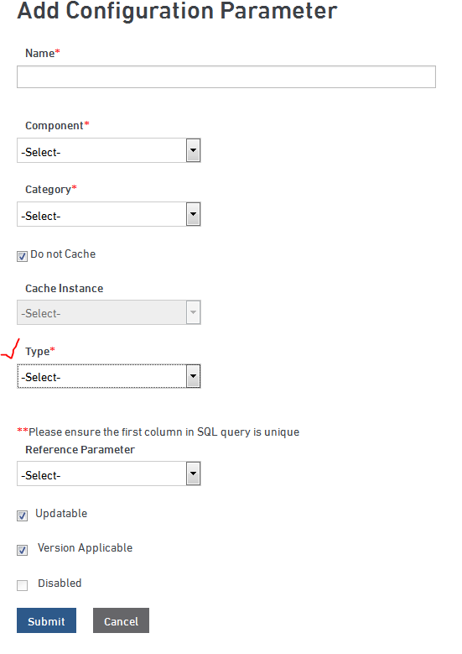
Continuing…

Slide 17
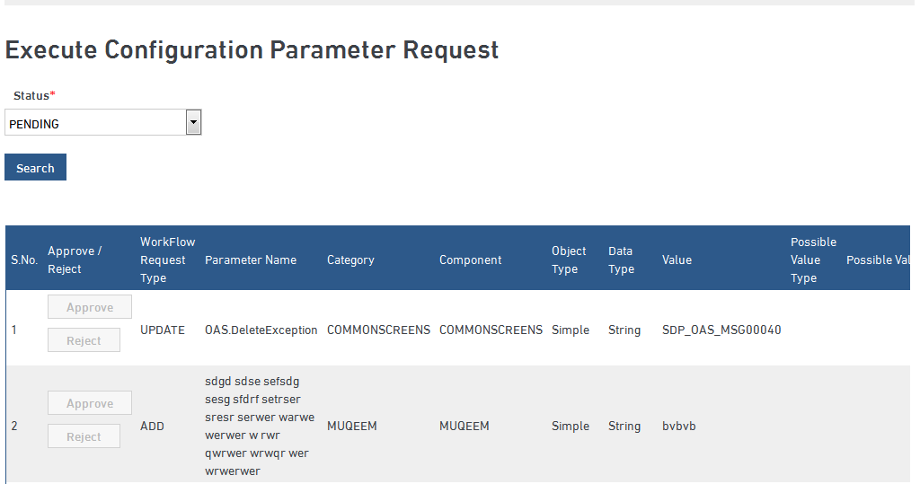
Continuing…

Slide 18
SDP Audit…
SDP Audit : This is specifically for portal to keep track of transactions that take place between Portal & Web methods. For utilizing this, you need to use SDPaudit.jar from where you can import required method signatures.
Before & After Invoking the Web methods, we need to make an entry by using the method signature “performAudit (……..)”
In exception block make sure you have an entry of method signature “performAudit (….)” which will track the exception trace.
Please find the below screenshot for your reference.

Slide 19
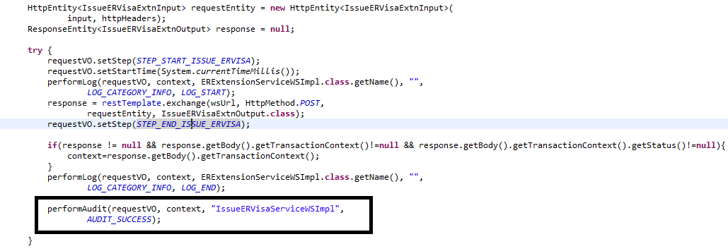
Continuing…

Slide 20
SDP Exception…
SDP Exception : This is a user defined Exception specifically for portal to Throw Exceptions whenever any Error Occurs.

Slide 21
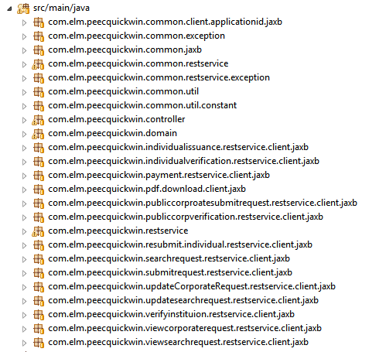

Portlet Development and Version Control
Package Structures
We have a specific package structures which needs to be followed for development. Please find the below screenshot for your reference.
Package Structure : com.elm.xxx(project name in shortcut)

Slide 22
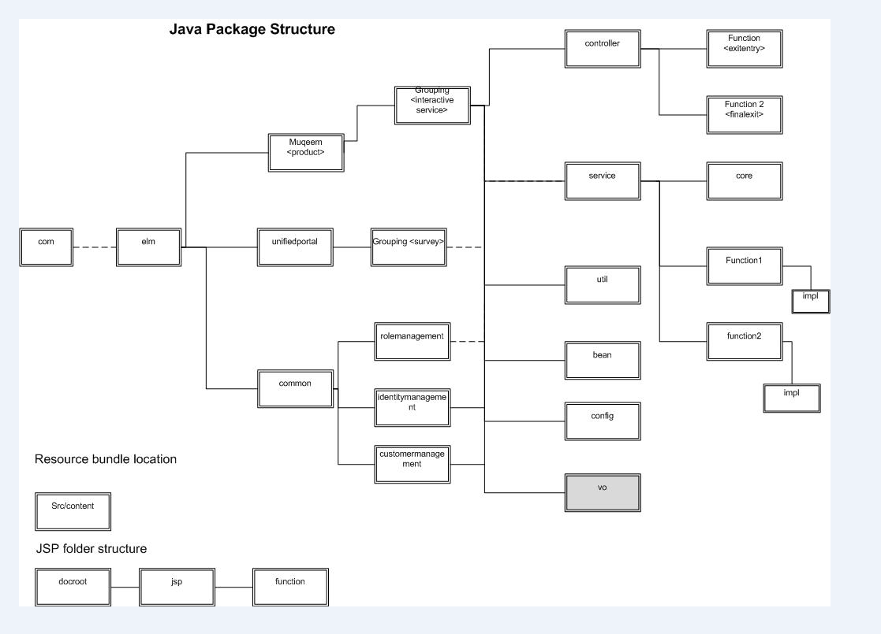
Continuing…

Slide 23
Continuing…
The Java Controller naming Convention includes the following path com.elm.<PortletName>.controller
The Service Layer Classes naming convention includes the following path :
com.elm.<PortletName>.service
The Rest Service Layer Classes naming convention includes the following path :
com.elm.<PortletName>.restservice
JSPs are included under the folder with the Portlet Name under the WEB-INF Folder

Slide 24
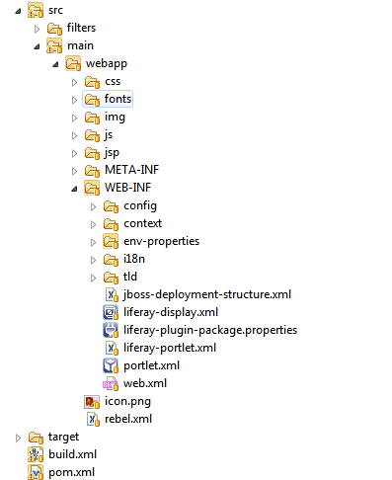
Continuing…
This explains the structure of the entire web information starting with deployment descriptor.
Maven build tool will be using to build and deploy the applications.
So we can make all the common libraries/plugins stored in maven repository.Hence development will become ease.

Slide 25
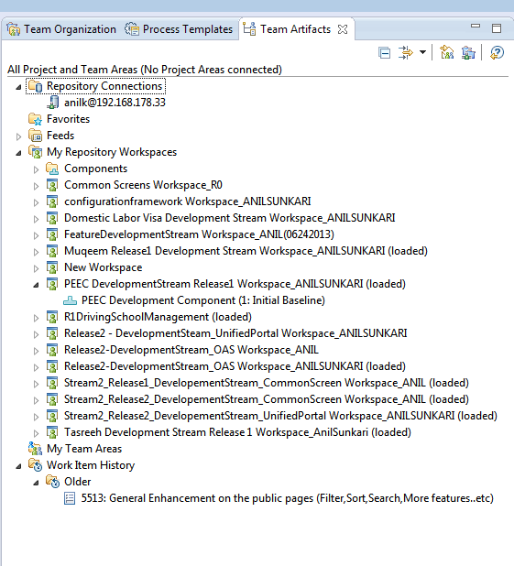
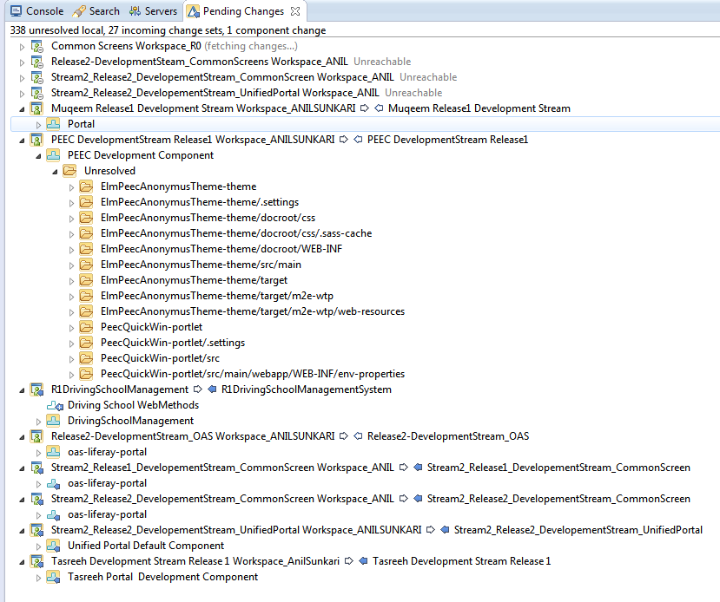
Continuing…

Slide 26
SDP Core Common Database Tables Interaction for portal
  TBL_COMMON_ORDER_REGISTRATION_USER_LOGIN
  TBL_COMMON_USER_LOGIN
  TBL_COMMON_PARTY_ROLE
  TBL_COMMON_ASSIGNED_PARTY_ROLE
  TBL_COMMON_PRODUCT
  TBL_COMMON_LOOKUP_CATEGORY
  TBL_COMMON_LOOKUP_ITEM
  TBL_COMMON_ROLE
  TBL_COMMON_FUNCTION
  TBL_COMMON_PRIVILEGE
  TBL_COMMON_PRIVILEGE_FUCNTION
  TBL_COMMON_PRODUCT_FUNCTION
  TBL_CONFIG_PARAM
  TBL_COMMON_USER_ROLE
  TBL_COMMON_USER_PARTY_ROLE
  Note : All the above tables are few and most commonly used w.r.t to portal interaction.Other than these you will find product/application level tables and few more common tables

Slide 27
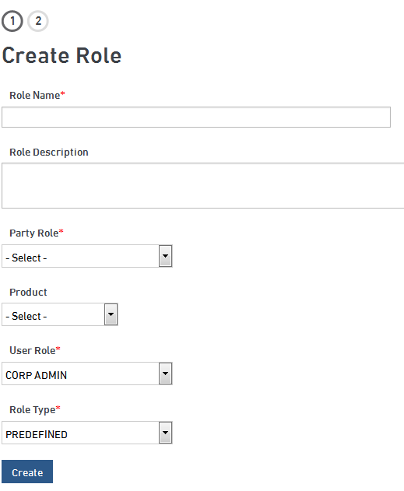
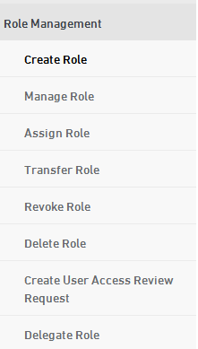
Role Creation
As shown in screenshot below is to create role w.r.t product/applicationon multiple criteria basis base don business requirement.

Slide 28
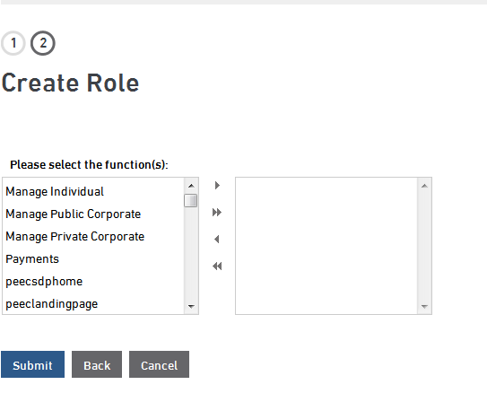
Continuing…

Slide 29
WSO2 Integration
All the implemented service which will interact with portal GUI to Webmethods(Wm) middleware server.
Here comes the mid-authentication layer called WSO2 where it will authenticate the given request by the user is valid or not.
Based on the WSO2 validation result passed. So, request will be processed further. (Or) request will sent back to portal saying it is not authorized.
So , before migrating to the futher environments portal team will be preparing the required inputs for WSO2 deployment w.r.t application/product.

Slide 30
Deployment Process & Environments
For Initial development we need to start with local environment.
Once all the development has been completed in local environment. Then we will deploy the code in next level environment i.e. DEV(Linux Box), where we need to perform end-to-end testing of our module/application & make sure it is available for next level testing and then it will be deployed to SIT environment.
The purpose of SIT environment is that it should be a stabilized application which will be executed/tested by Wipro testing team & confirms the availability for the next level environments.
Same way, the Stabilized application will be moved to different environments like UAT, Stage and Production.
Below are the migration environments :
Development Environment
System Integration Testing(SIT)
User Acceptance Testing(UAT)
Staging Environment (Pre-production)
Product Environment (Clustered)

Slide 31
Continuing with LAR configuration
As part of development we will be configuring Site, Pages/layouts, Layout Templates,Theme(Specific Look-and-feel) & friendly-urls.
Once site created and configured with theme & layouts. Next step is to configure portlet plugins on those pages.
Site Configurations
For configuring site in any of the environment. You need to follow set of SDP standards.
Site must be a public site with all public pages.
No special characters are recommended in site or friendly urls
Site name should be specified as per Business Requirement
Once site has been created and to make it available under top menu, which is based on logged-in user role based, you need to follow the appropriate function privilege mappings.

Slide 32
Continuing….
Applying themes and color schemes
In Order to Apply Themes and Color Schemes, the Prerequisite is that the Theme should have been deployed in the Server
Then deploy your portlet in the Server
Login as Portal Administrator and go to Control Panel
In Control Panel, Select your Site and click on Site Pages
Click on the required page for which you want to apply the theme
Upon Selection of the page, it will display Look and Feel option on the right side. Click on that option which will display the list of themes available at the bottom of the page
Select the Theme which you want to apply for your page
Upon Selection of Theme, Select the Color Scheme which will be specified to your product and then click on save which will apply that theme and color scheme to your required page

Slide 33
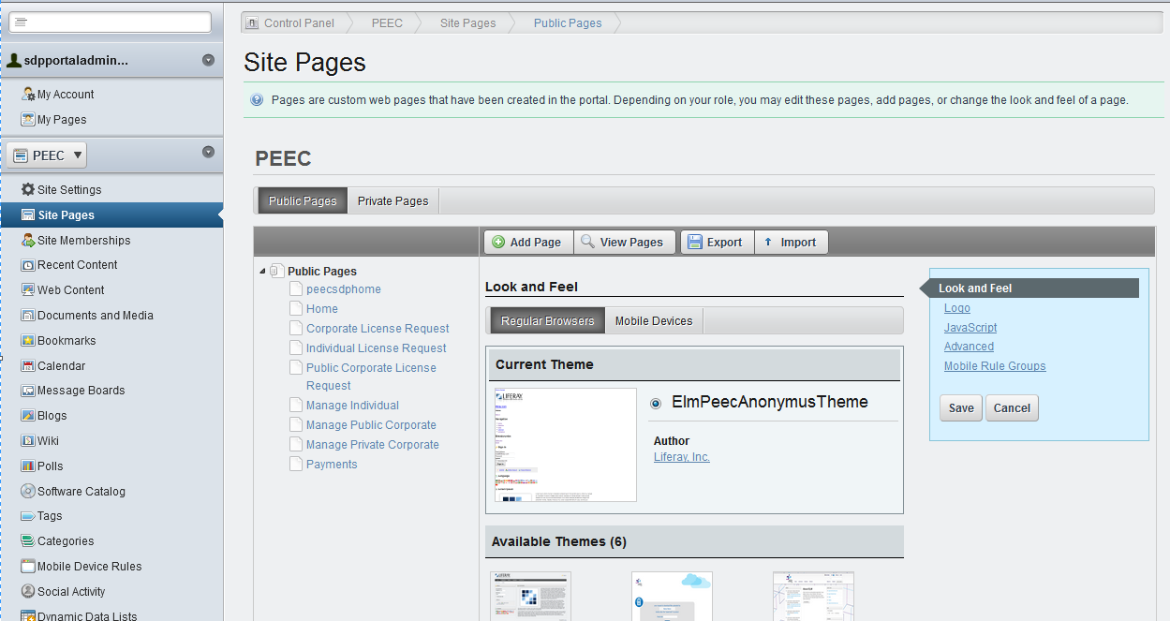
Continuing…

Slide 34
Creating new portlet using Spring MVC
Create a new Liferay Project using Liferay IDE
Specify the Project name and Display name
Select the required Liferay PlugIns SDK and Liferay Tomcat(7.0) as Liferay Portal Runtime Server
Select the Plug In Type as Portlet and Click on Next
Select the Portlet Framework as Liferay MVC and Click on Finish
Create the Spring Context file of your choice
Open the Portlet.xml file and set the Spring Context File Location in the init-param section

Slide 35
Deployment Process Steps
Prepare release note called as MRF which in detail describe about the deployment process in sequence order and tells about the source of access w.r.t each deployment process.
List of checklist :
  MRF
  LAR File
  WAR File
  DB Scripts
  WSO2 Configuration Sheets

Slide 36
Post Deployment Process
Below are the pre-request sites to be done before accessing the application/product on SDP.
Identity Registration
Party Registration
Package Assignment
Package Subscription
Role Creation
User Creation & Role assignment
Once all the above are completed. So, then user can login into SDP and access the application/product.

Slide 37


Slide 38


